Slide 1



Noida Institute of Engineering and Technology, Greater Noida
JSP
DAY 4
Subject Name: ADVANCED JAVA PROGRAMMING
Faculty Name:
Dr. Vineet
Computer Science & Engineering
Course Details: B Tech 6th Sem

Slide 2

Faculty Profile
Experience | Details
Total Experience | 25 years
Teaching Experience | Worked as Vice Principal in an Indian school Kuwait for 24 years, Worked as Asst. Professor in PTU Chandigarh

Slide 3
Faculty Profile: Coursera Achievements
Education Background | Details
PhD. In CSC(2022) | Himalayan Garhwal University
MIT (2006) | Sikkim Manipal University
B.E.(comp) | Pune University
B.Ed. | IGNOU

Slide 4
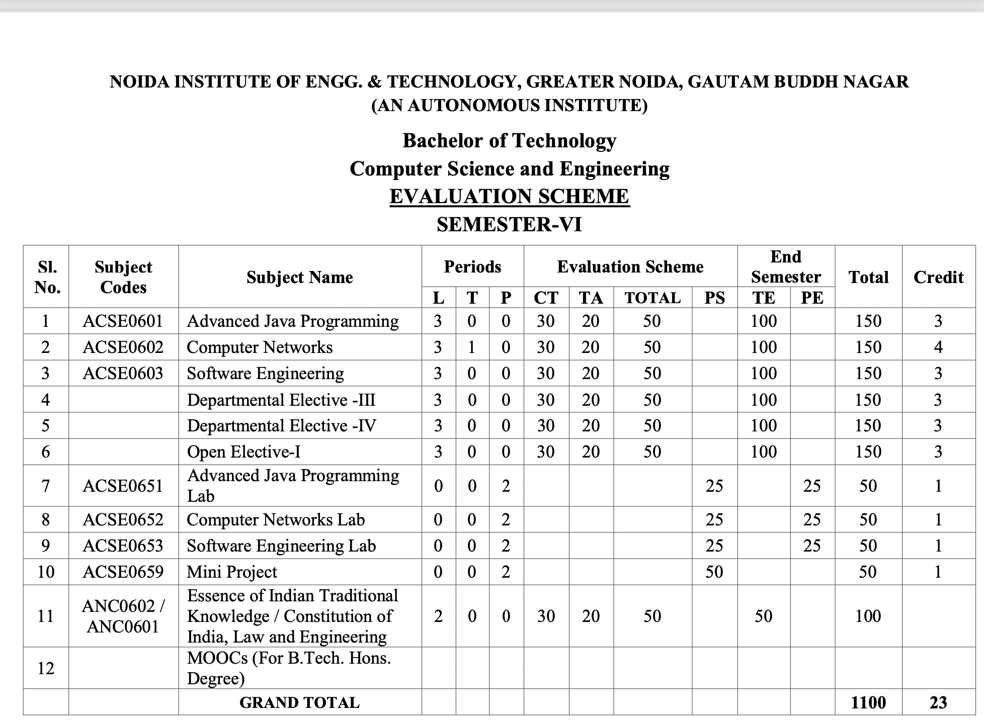
Evaluation Scheme

Slide 5
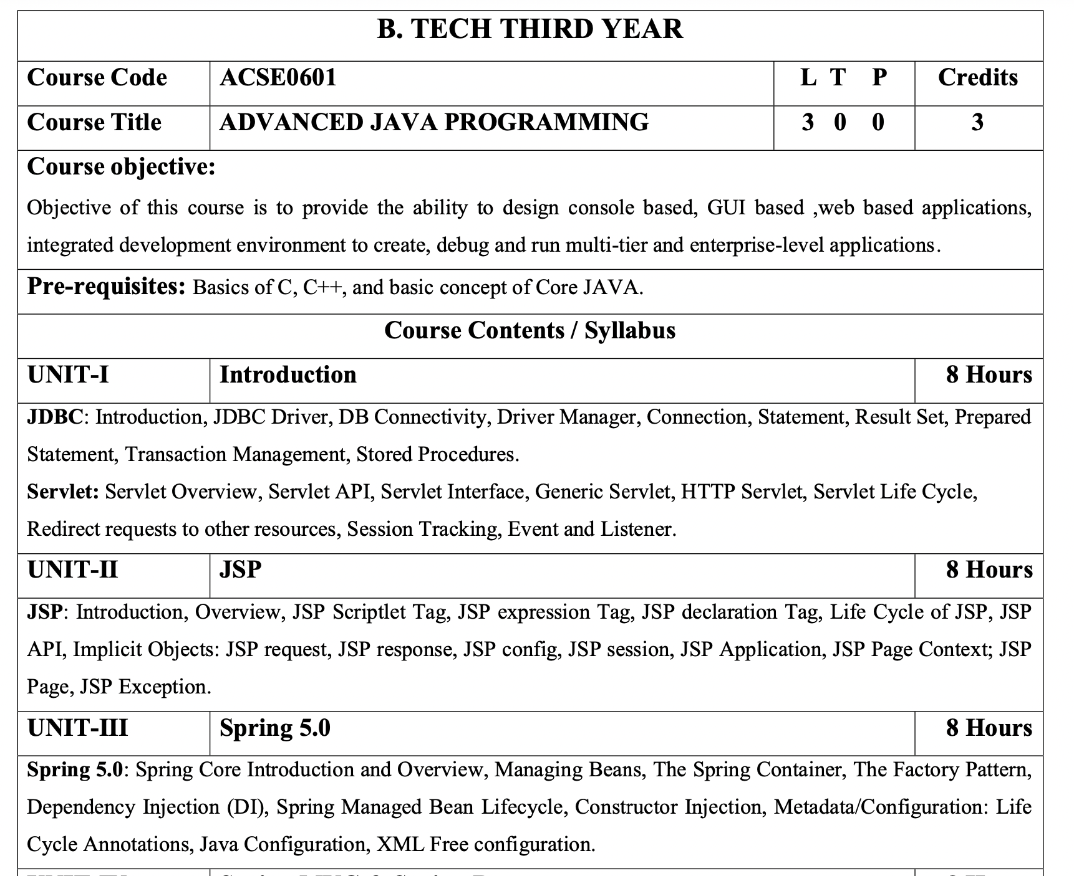
Syllabus

Slide 6
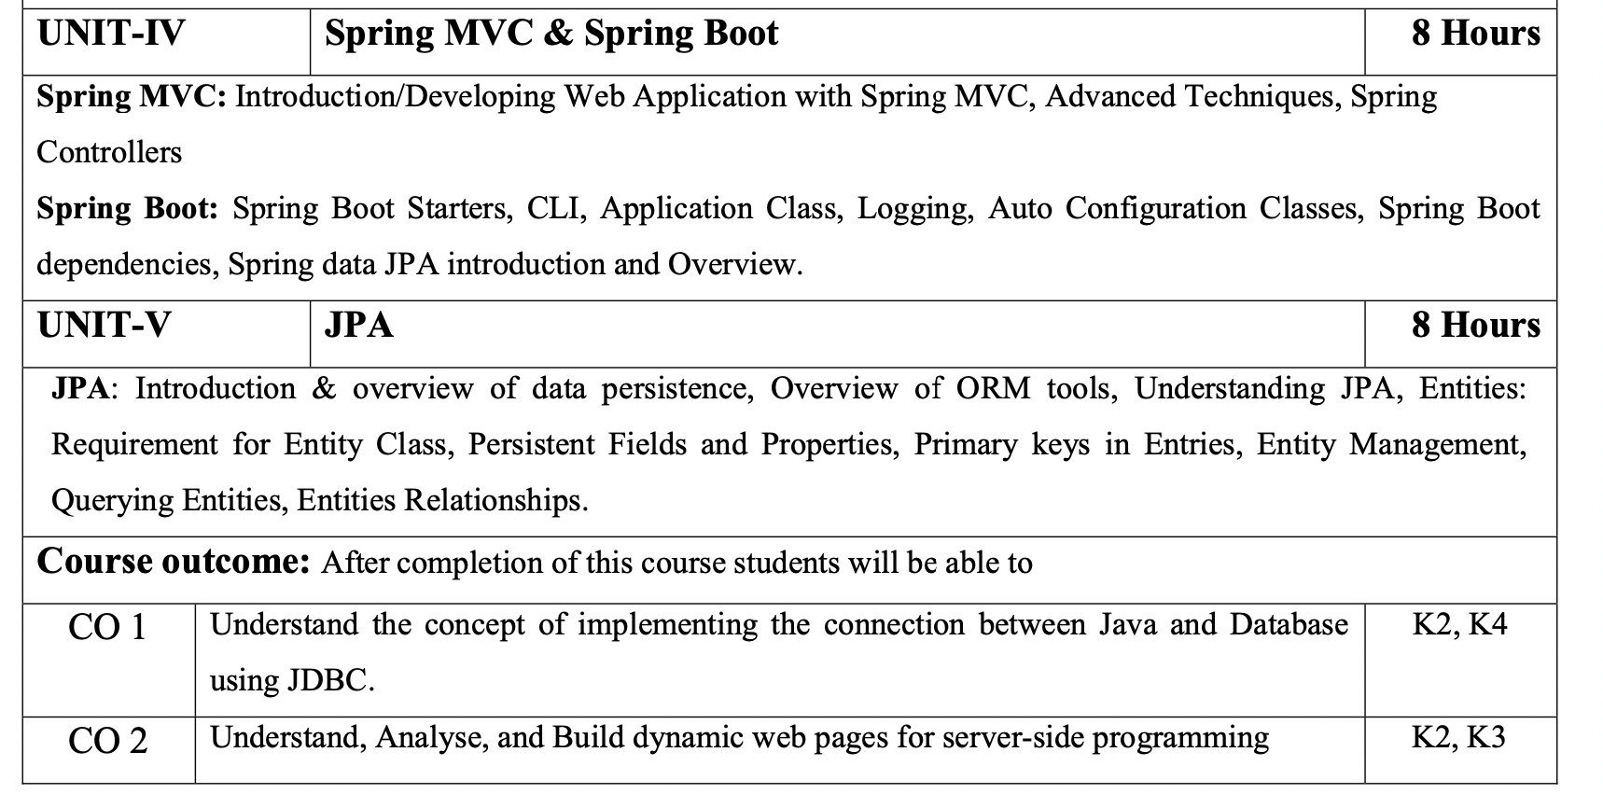
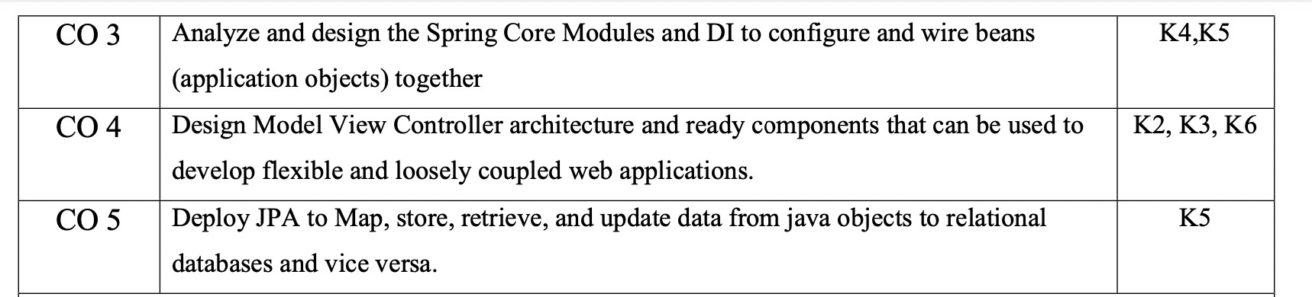
Syllabus

Slide 7
Content
JSP: Introduction
Overview
JSP Scriptlet Tag
JSP expression Tag
JSP declaration Tag
Life Cycle of JSP
JSP API
Implicit Objects: JSP request
JSP response
JSP config
JSP session
JSP Application
JSP Page Context
JSP Page
JSP Exception

Slide 8
Course Objective
Objective of this course is to provide the ability to design console based, GUI based ,web based applications, integrated development environment to create, debug and run multi-tier and enterprise-level applications.

Slide 9
Course Outcome
After completion of this course, students will be able to-
CO1: Understand the concept of implementing the connection between Java and Database using JDBC.
CO2: Understand, Analyse, and Build dynamic web pages for server-side programming
CO3: Analyze and design the Spring Core Modules and DI to configure and wire beans (application objects) together
CO4: Design Model View Controller architecture and ready components that can be used to develop flexible and loosely coupled web applications.
CO5: Deploy JPA to Map, store, retrieve, and update data from java objects to relational databases and vice versa.

Slide 10
Program Outcomes (POs)
Engineering Graduates will be able to:
PO1 : Engineering Knowledge
PO2 : Problem Analysis
PO3 : Design/Development of solutions
PO4 : Conduct Investigations of complex problems
PO5 : Modern tool usage
PO6 : The engineer and society

Slide 11
Program Outcomes (POs) cont…
Engineering Graduates will be able to:
PO7 : Environment and sustainability
PO8 : Ethics
PO9 : Individual and teamwork
PO10 : Communication
PO11 : Project management and finance
PO12 : Life-long learning

Slide 12
CO – PO and PSO Mapping
CO.K | PO1 | PO2 | PO3 | PO4 | PO5 | PO6 | PO7 | PO8 | PO9 | PO10 | PO11 | PO12
ACSE0601.1 | 3 | 3 | 3 | 3 | 2 | - | - | - | 2 | 2 | - | 3
ACSE0601.2 | 3 | 3 | 3 | 3 | 2 | 2 | - | 1 | 1 | 1 | - | 3
ACSE0601.3 | 3 | 3 | 2 | 3 | 3 | 2 | - | 2 | 1 | 1 | 2 | 3
ACSE0601.4 | 3 | 3 | 3 | 3 | 2 | 2 | - | 2 | 2 | 1 | 3 | 3
ACSE0601.5 | 2 | 2 | 2 | 2 | 2 | 2 | - | 2 | 1 | 1 | 1 | 2
Average | 2.8 | 2.8 | 2.6 | 2.8 | 2.2 | 1.6 | - | 1.8 | 1.4 | 1.2 | 1.2 | 2.8

Slide 13
Program Educational Objectives (PEOs)
Program Educational Objectives (PEOs) | PEOs Description
PEOs | To have an excellent scientific and engineering breadth so as to comprehend, analyze, design and provide sustainable solutions for real-life problems using state-of-the-art technologies.
PEOs | To have a successful career in industries, to pursue higher studies or to support entrepreneurial endeavors and to face the global challenges.
PEOs | To have an effective communication skills, professional attitude, ethical values and a desire to learn specific knowledge in emerging trends, technologies for research, innovation and product development and contribution to society.
PEOs | To have life-long learning for up-skilling and re-skilling for successful professional career as engineer, scientist, entrepreneur and bureaucrat for betterment of society.

Slide 14
End Semester Question Paper Template
B TECH
(SEM-V) THEORY EXAMINATION 20__-20__
COMPILER DESIGN
Time: 3 Hours Total Marks: 100
Note: 1. Attempt all Sections. If require any missing data; then choose suitably.
SECTION A
Attempt all questions in brief. 2 x 10 = 20
Q.No. | Question | Marks | CO
1 |  | 2
2 |  | 2
. |  | .
10 |  | 2
Surbhi Jha ACSE0601 Unit-II

Slide 15
End Semester Question Paper Templates
SECTION B
2. Attempt any three of the following: 3 x 10 = 30
SECTION C
3. Attempt any one part of the following: 1 x 10 = 10
Q.No. | Question | Marks | CO
1 |  | 10
2 |  | 10
. |  | .
5 |  | 10
Q.No. | Question | Marks | CO
1 |  | 10
2 |  | 10
Surbhi Jha ACSE0601 Unit-II

Slide 16
Prerequisite
Pre-requisites: Basics of C, C++, and basic concept of Core JAVA.

Slide 17
Brief Introduction about the subject with videos
Advanced Java is everything that goes beyond Core Java – most importantly the APIs defined in Java Enterprise Edition, includes Servlet programming, Web Services, the Persistence API, etc. It is a Web & Enterprise application development platform which basically follows client & server architecture.
https://youtu.be/vHmUVQKXlVo
https://youtu.be/qz0aGYrrlhU

Slide 18
Unit Objective
.
To get detailed insights of JSP.

Slide 19
Topic Objective
JDBC: Introduction, JDBC Driver, DB Connectivity, Driver Manager, Connection, Statement, Result Set, Prepared Statement, Transaction Management, Stored Procedures. Servlet: Servlet Overview, Servlet API, Servlet Interface, Generic Servlet, HTTP Servlet, Servlet Life Cycle, Redirect requests to other resources, Session Tracking, Event and Listener. | It provides universal data access from the Java programming language.
JSP: Introduction, Overview, JSP Scriptlet Tag, JSP expression Tag, JSP declaration Tag, Life Cycle of JSP, JSP API, Implicit Objects: JSP request, JSP response, JSP config, JSP session, JSP Application, JSP Page Context; JSP Page, JSP Exception. | To learn creating web application.
Spring 5.0: Spring Core Introduction and Overview, Managing Beans, The Spring Container, The Factory Pattern, Dependency Injection (DI), Spring Managed Bean Lifecycle, Constructor Injection, Metadata/Configuration: Life Cycle Annotations, Java Configuration, XML Free configuration. | To understand Java framework which is used to build web applications.

Slide 20
Topic Objective
Spring MVC: Introduction/Developing Web Application with Spring MVC, Advanced Techniques, Spring Controllers Spring Boot: Spring Boot Starters, CLI, Application Class, Logging, Auto Configuration Classes, Spring Boot dependencies, Spring data JPA introduction and Overview. | To learn design pattern that separates the business logic, presentation logic and data.
JPA: Introduction & overview of data persistence, Overview of ORM tools, Understanding JPA, Entities: Requirement for Entity Class, Persistent Fields and Properties, Primary keys in Entries, Entity Management, Querying Entities, Entities Relationships. | To learn how we can examine, control, and persist data between Java objects and relational databases.

Slide 21
DAY 4 OBJECTIVES
Life Cycle of JSP
JSP API
Implicit Objects: JSP request

Slide 22
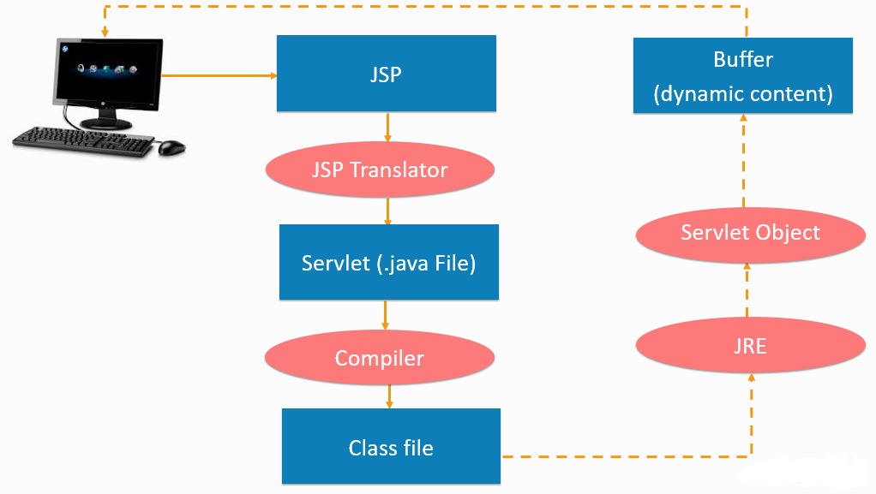
Life Cycle of JSP Page(CO2)

Slide 23
Lifecycle of JSP Cont… (CO2)
1. JSP page translation: A Java servlet file is created from the JSP source file. In the translation phase, the container validates the correctness of the JSP pages and tag files.
2. JSP page compilation: The created java servlet file is compiled into a Java servlet class.
3. Class loading: The java servlet class that was compiled from the JSP source is now loaded into the container.
4. Execution phase: In the execution phase, the container creates one or more instances of this class in response to the requests. The interface JsP Page contains jspInit() and jspDestroy(). JSP provides special interface HttpJspPage for JSP pages specifically for the HTTP requests and this interface contains _jspService().
5. Initialization: jspInit() method is called immediately after the instance is created.
6. jspDestroy() execution: This method is called when JSP is destroyed. With this call, the servlet completes its purpose and goes into the garbage collection This ends the JSP life cycle.
There are certain life cycle methods provided in JSP, these are: jspInit(), _jspService() and jspDestroy(), explained above.
Learning about the lifecycle is important. It gives you an insight into the actual functioning. Now, let us see and understand the syntax used in creating a JSP page.

Slide 24
JSP API (CO2)
JSP API is a set of classes and interfaces that can be used to make a JSP page. These classes and interfaces are contained in the javax servlet.jsp packages. A portion of the classes characterized in the javax. servlet.jsp packages are:
Error Data
JSP Writer
Page Context
The Error Data Class: The error information class characterizes error data for error pages. You have to set the estimation of the page mandate, isErrorPage to be consistent with demonstrating that a page is an error page. The error information class expands the java.lang.Object class. A portion of the strategies characterized in the ErrorData that you can use in a JSP page is:
getRequestURL(): Returns the mentioned URL through String.
getServletName(): Returns the name of the servlet conjured through String.
getStatusCode(): Returns the status code of the blunder as a whole number.
getThrowable(): Returns the Throwable special case that caused the mistake.

Slide 25
JSP API Cont…(CO2)
The JspWriter Class: In a JSP page to compose activity and layout information we can utilize JSPWriter class. The understood variable out gives the JSPWriter class object. The JSPWriter class broadens the java.io.Writer class. A portion of the techniques characterize in the JSPWriter class that you can use in a JSP page are:
clear(): Clears the substance of the cradle. The reasonable() technique tosses an IOException special case if the support is now cleared.
close(): Closes and flushes the stream.
flush(): Flushes the cradle stream. The flush() strategy flushes every one of the cradles in a chain of Writers and OutputStream. It tosses java.io.IOException special case on the off chance that you make a call to the compose() or flush() in the wake of shutting the stream.
getBufferSize(): Return the size of the support utilized by the JSPWriter.
print(): Prints the estimation of sort boolean, integer, character, long whole number, coasting point, twofold exactness gliding – point number, a variety of character, string, and item. The print() tosses the java.io.IOException exemption if any blunder happens while printing.
println(): Prints an estimation of sort boolean, whole number, character, long whole number, drifting point, twofold exactness coasting point number, a variety of character, string, and article. The Println() tosses the java.io.IOException exemption if any blunder happens while printing.

Slide 26
JSP API Cont…(CO2)
The PageContext Class: The setting data is given by the PageContext class when the JSP innovation is utilized in the servlet condition. The PageContext class expands the JSPContext class. A PageContext occasion furnishes access to namespaces related to the JSP page. Some of the strategies characterized in the PageContext class are:
forward(): Redirects the current servlet demand and servlet reaction to another page. This strategy acknowledges the URL of an objective page as a contention.
getPage(): Returns the present estimation of the page object.
getRequest(): Returns the present estimation of the solicitation object. The servlet solicitation is the arrival kind of getRequest().
getResponse(): Returns the present estimation of the reaction object. The return kind of the getResponse() technique is the servlet reaction.
getServletConfig(): Returns the ServletConfig of the present page.
getServletContext(): Returns the ServletContext of the present page.
getSession(): The arrival kind of getSession() is HttpSession. It will restore the current PageContext.
include(): Processes the current servlet demand and the reaction determined in the URL. The incorporate() technique accepts two contentions, a URL way and the flush estimation of boolean sort.

Slide 27
Session Tracking in JSP (CO2)
Cookies: A little message field put away on the customers machine. The treat can be impair in the program settings so they are not constantly accessible.
URL revamping: Store session data in the URL. Works, when treats are not bolstered yet, can make bookmarking of site pages an issue since they have session explicit data toward the finish of a URL.
Avoided fields: HTML covered up alter boxes, for example:
<input type = "hidden">
Session objects: JSP Implicit Object. A session article utilizes a key/esteem mix to store information. To retrieve data from a session:
session.getValued("msg")
The arrival kind of the strategy getValue is Object, so you should typecase to get the required worth. Invalid is returned when there is no such key with the session name.

Slide 28
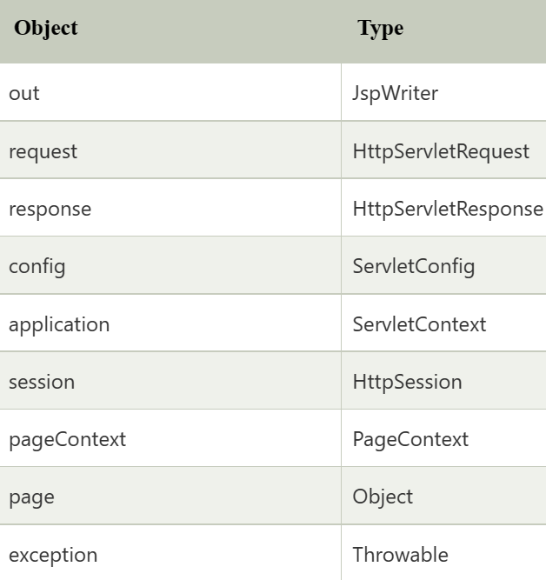
JSP IMPLICIT OBJECTS(CO2)
There are 9 jsp implicit objects.
These objects are created
by the web container that
are available to all the
jsp pages.

Slide 29
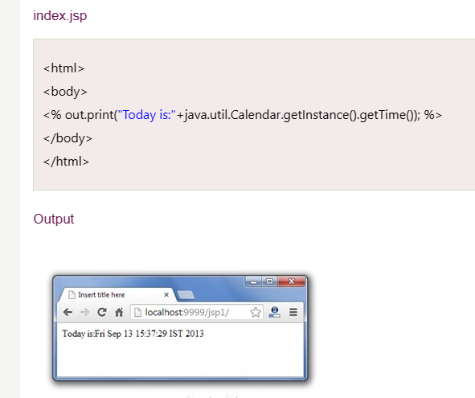
out object
For writing any data to the buffer, JSP provides an implicit object
named out. It is the object of JspWriter.
In case of servlet you need to write
PrintWriter out=response.getWriter();
but in servlet we do not have to write
this

Slide 30
Implicit Objects: JSP request(CO2)
The JSP request is an implicit object of type HttpServletRequest i.e. created for each jsp request by the web container. It can be used to get request information such as parameter, header information, remote address, server name, server port, content type, character encoding etc.
It can also be used to set, get and remove attributes from the jsp request scope.
Let's see the simple example of request implicit object where we are printing the name of the user with welcome message.
Example of JSP request implicit object
Index.html
<form action="welcome.jsp">
<input type="text" name="uname">
<input type="submit" value="go"><br/>
</form>

Slide 31
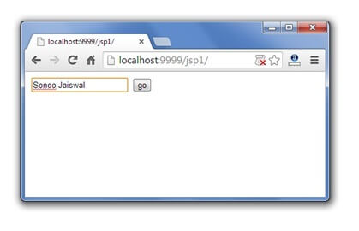
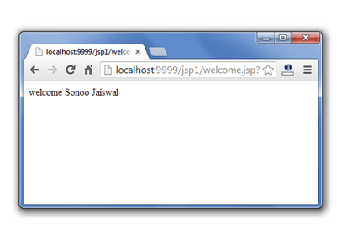
Example of JSP request implicit object Cont…(CO2)
welcome.jsp
<%
String name=request.getParameter("uname");
out.print("welcome "+name);
%>

Slide 32
Daily Quiz
Which page directive should be used in JSP to generate a PDF page? a) contentType b) generatePdf c) typePDF d) contentPDF
Which tag should be used to pass information from JSP to included JSP? a) Using <%jsp:page> tag b) Using <%jsp:param> tag c) Using <%jsp:import> tag d) Using <%jsp:useBean> tag
Application is instance of which class? a) javax.servlet.Application b) javax.servlet.HttpContext c) javax.servlet.Context d) javax.servlet.ServletContext

Slide 33
Weekly Assignment
Discuss the concept of JSP.
Explain JSP Scriplet Tag.
Illustrate JSP expression Tag.
Summarize JSP declaration Tag.
What do you understand by life cycle of JSP?

Slide 34
Daily Quiz
_jspService() method of HttpJspPage class should not be overridden. a) True b) False
Which option is true about session scope? a) Objects are accessible only from the page in which they are created b) Objects are accessible only from the pages which are in same session c) Objects are accessible only from the pages which are processing the same request d) Objects are accessible only from the pages which reside in same application
Which one is the correct order of phases in JSP life cycle? a) Initialization, Cleanup, Compilation, Execution b) Initialization, Compilation, Cleanup, Execution c) Compilation, Initialization, Execution, Cleanup d) Cleanup, Compilation, Initialization, Execution

Slide 35
Weekly Assignment
How we can apply JSP API?
Discuss the concept Implicit Objects.
Explain JSP request.
Illustrate JSP response.
Summarize JSP config.
What do you understand by JSP session?
How we can apply JSP Application?
Briefly explain JSP Page Context
How to create a JSP page?
How can we handle the exception in JSP?

Slide 36
Faculty Video Links, Youtube & NPTEL Video Links and Online Courses Details
Youtube/other Video Links
https://youtu.be/BsDoLVMnmZs
https://youtu.be/a8W952NBZUE
https://www.youtube.com/watch?v=J_d1fJy90GY&t=4s

Slide 37
Daily Quiz
session is instance of which class?
A - Session
B - HttpSession
C - HttpServletSession
D - ServletSession
What is the correct signature of jspInit() method of HttpJspPage class?
A - void jspInit(HTTPRequest request, HTTPResponse response)
B - void jspInit(HTTPRequest request, HTTPResponse response) throws ServletException, IOException
C - void jspInit()
D - void jspInit() throws ServletException, IOException

Slide 38
Expected Questions for University Exam
Explain JSP and its elements?
Where is scriptlet tag used in JSP?
How to write the JSP expression?
Explain JSP declaration Tag with example.
Explain the phases available in JSP life cycle?
What is JSP API and how portion of the classes characterized in the javax. servlet.jsp packages?
What are the 9 implicit objects?
How to use request and response in JSP?
Explain JSP config.
How to maintain session in JSP?
What are the applications of JSP?
What is difference between page and PageContext in JSP?
What happens if an exception is thrown from a JSP?

Slide 39
Summary
JavaServer Pages (JSP) is a technology for developing Webpages that supports dynamic content. This helps developers insert java code in HTML pages by making use of special JSP tags, most of which start with <% and end with %>.
A scriptlet tag is used to execute java source code in JSP.
Expression tag is one of the scripting elements in JSP. Expression Tag in JSP is used for writing your content on the client-side.
Declaration tag is used to declare one or more variables or methods at class level.
A Java Server Page life cycle is defined as the process that started with its creation which later translated to a servlet and afterward servlet lifecycle comes into play. This is how the process goes on until its destruction.
JSP API is a set of classes and interfaces that can be used to make a JSP page.
Implicit objects are a set of Java objects that the JSP Container makes available to developers in each page.
The JSP request can be defined as an implicit object is an instance of "HttpServletRequest" and is formed for all JSP requests through the web container.

Slide 40
Summary Cont…
In JSP, response is an implicit object of type HttpServletResponse.
JSP Config is an implicit object which is used to transmit the configuration details to the JSP page.
In JSP, the session is the most regularly used implicit object of type HttpSession.
In JSP, application is an implicit object of type ServletContext. This is an instance of javax.servlet.ServletContext.
A PageContext instance is obtained by a JSP implementation class by calling the JspFactory.getPageContext() method, and is released by calling JspFactory.
A JSP page is a text document that contains two types of text: static data, which can be expressed in any text-based format (such as HTML, SVG, WML, and XML), and JSP elements, which construct dynamic content.
Exceptions in JSP occur when there is an error in the code either by the developer or internal error from the system.

Slide 41
References
Bhave, “Programming with Java”, Pearson Education, 2009
Herbert Schieldt, “The Complete Refernce: Java”, TMH, 1991
Hans Bergsten, “Java Server Pages”, SPD O’Really, 1985
Katy Sierra and Bert Bates, “Head First: Java”, O’Really, 2008
Katy Sierra and Bert Bates, “Head First: Servlets & JSP”, O’Really , 2008
NaughtonSchildt, “The Complete Refernce: JAVA2”, TMH ,1991
Balagurusamy E, “Programming in JAVA”, TMH, 2010
Introduction to Web Development with HTML,CSS,JavaScript(Cousera Course)

Slide 42
References
Thank You

